Slide 1
CENG 311
Computer Architecture Lab
INTRODUCTION

Slide 2
Office Hours:
Didem Genç Orhan Bayraktar
Room Number: 016 Room Number: 016
Wednesday 13:30-15:30 Monday 13:30-17:00

Slide 3
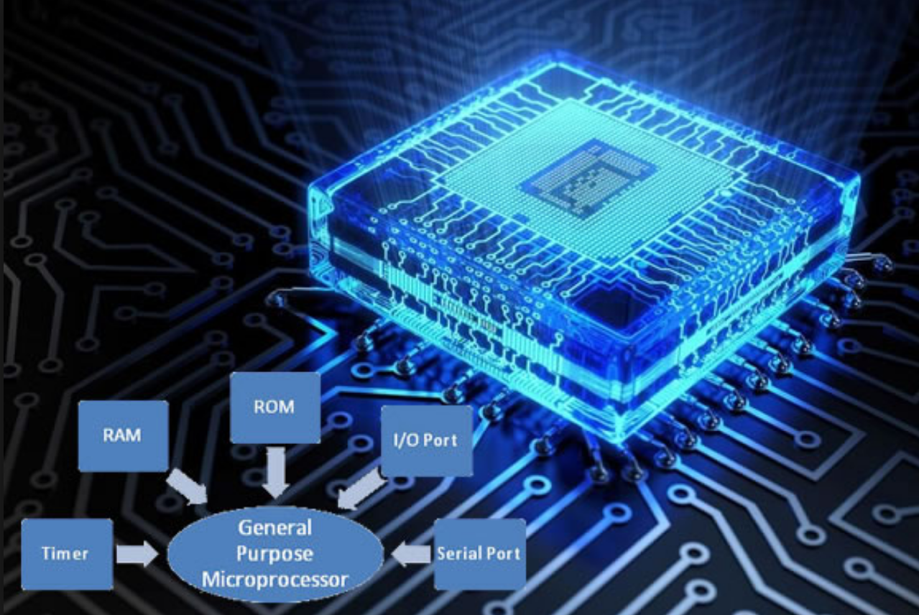
Objective of Lab Session
Design a 16bits general purpose microprocessor

Slide 4
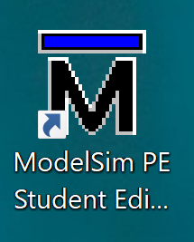
Simulation Tool : ModelSim
You can download ModelSim Student Edition

Slide 5
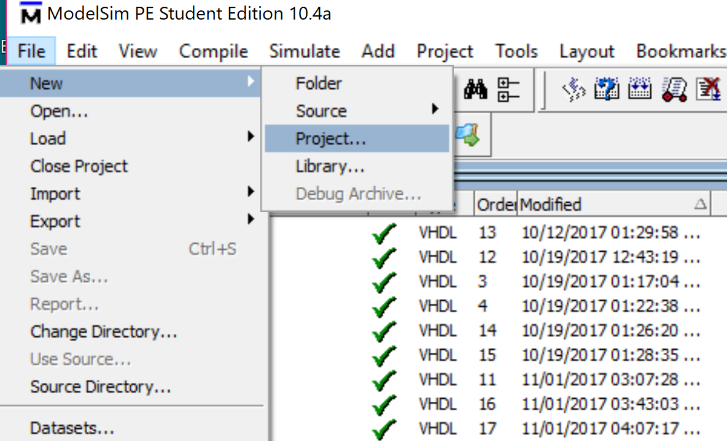
1.Open a new project

Slide 6
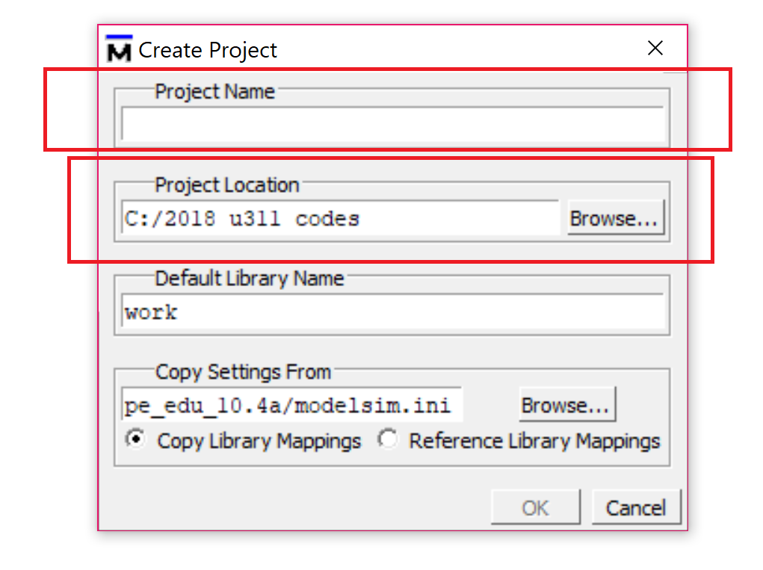
2. Name your Project and Choose the directory to be saved

Slide 7
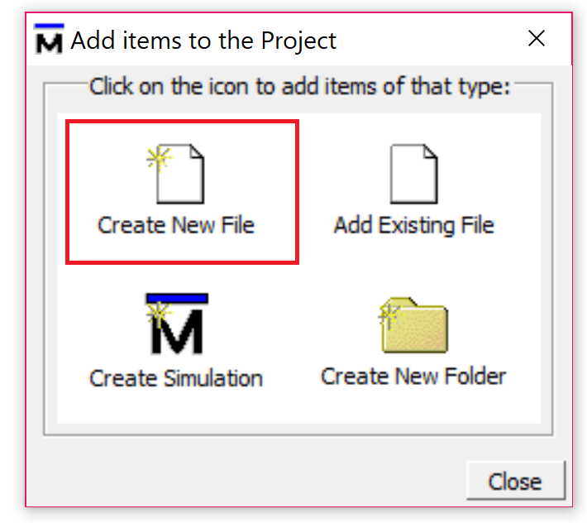
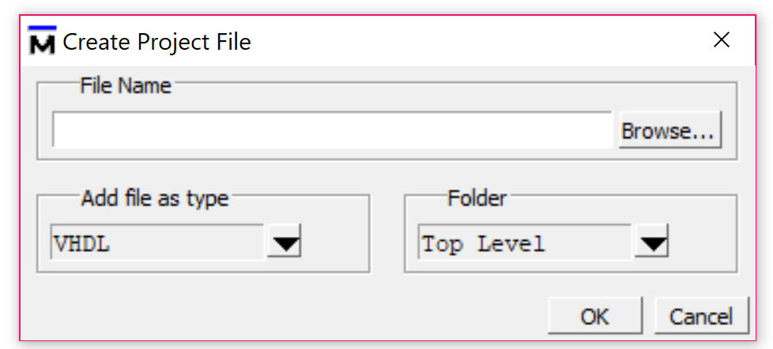
3. Create a new file and name your file

Slide 8
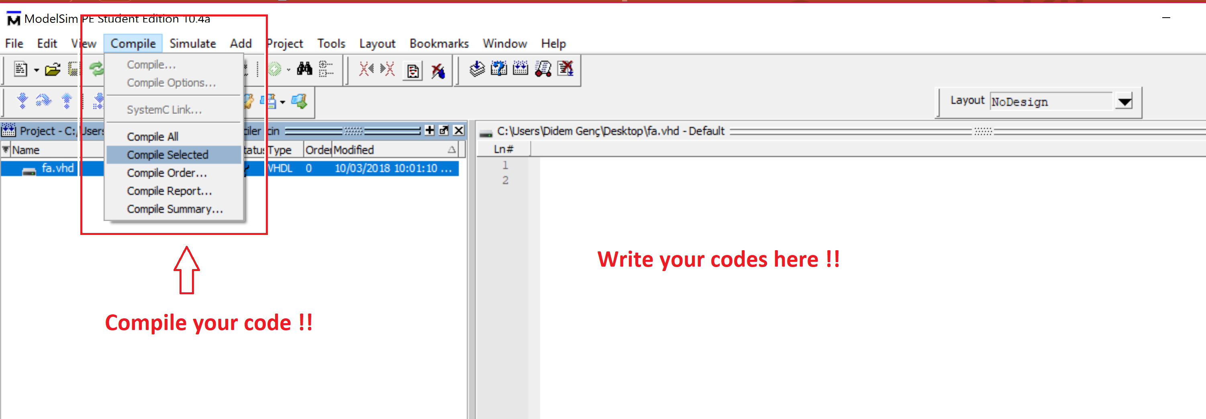
4. Write your codes, save your file, then compile it

Slide 9
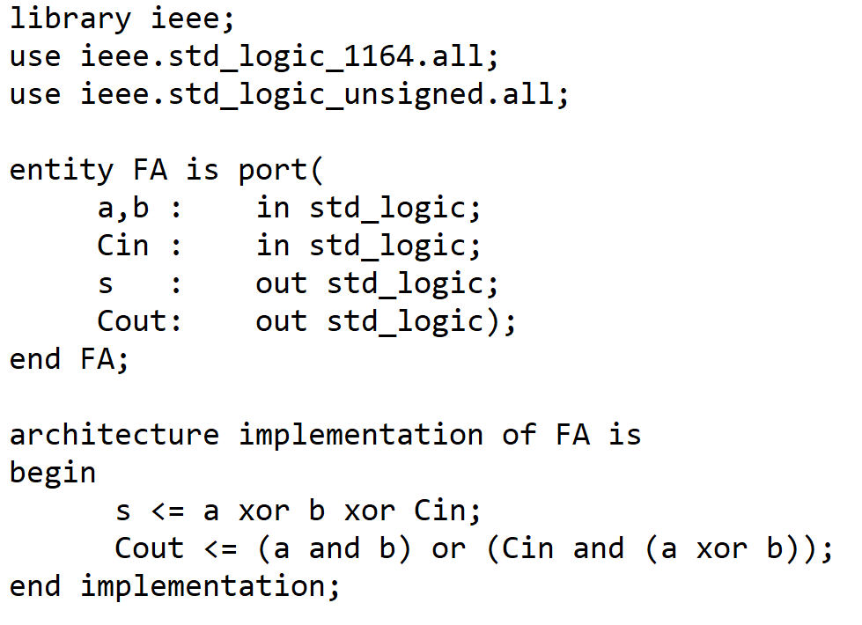
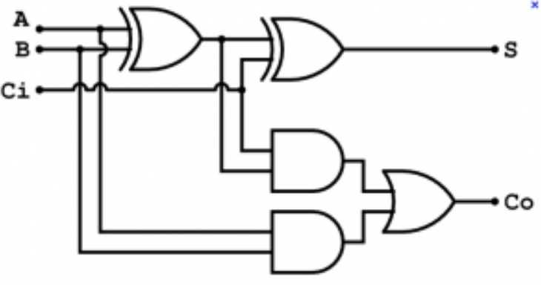
VHDL Code of Full Adder

Slide 10
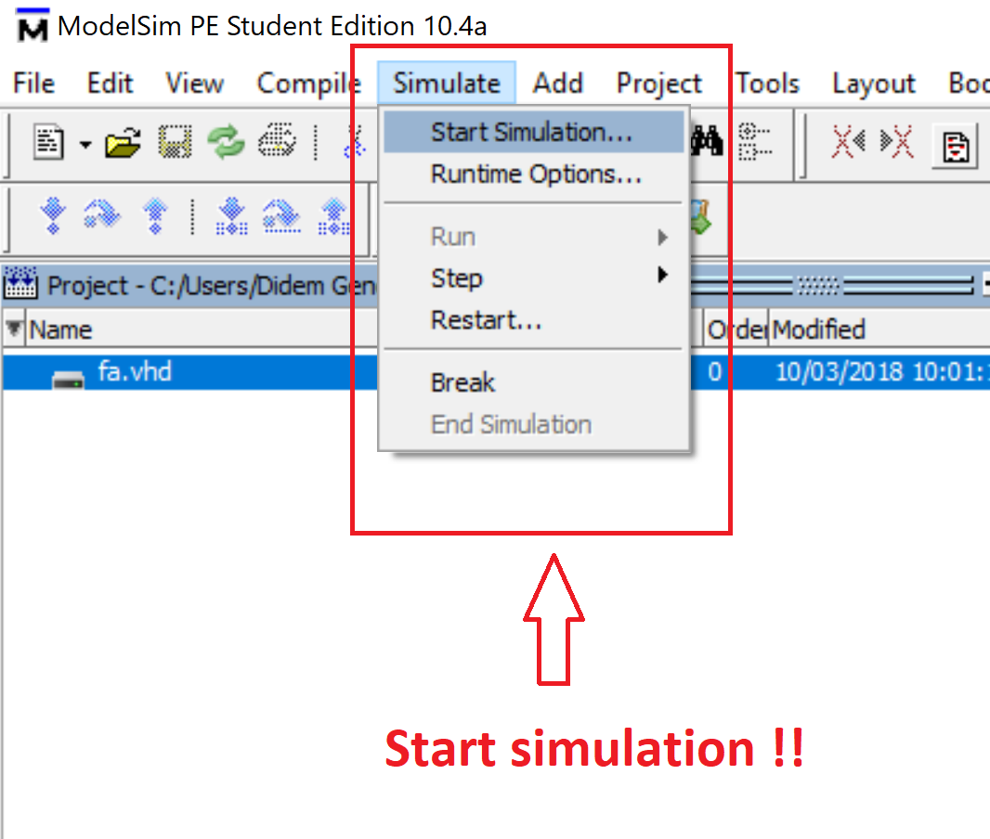
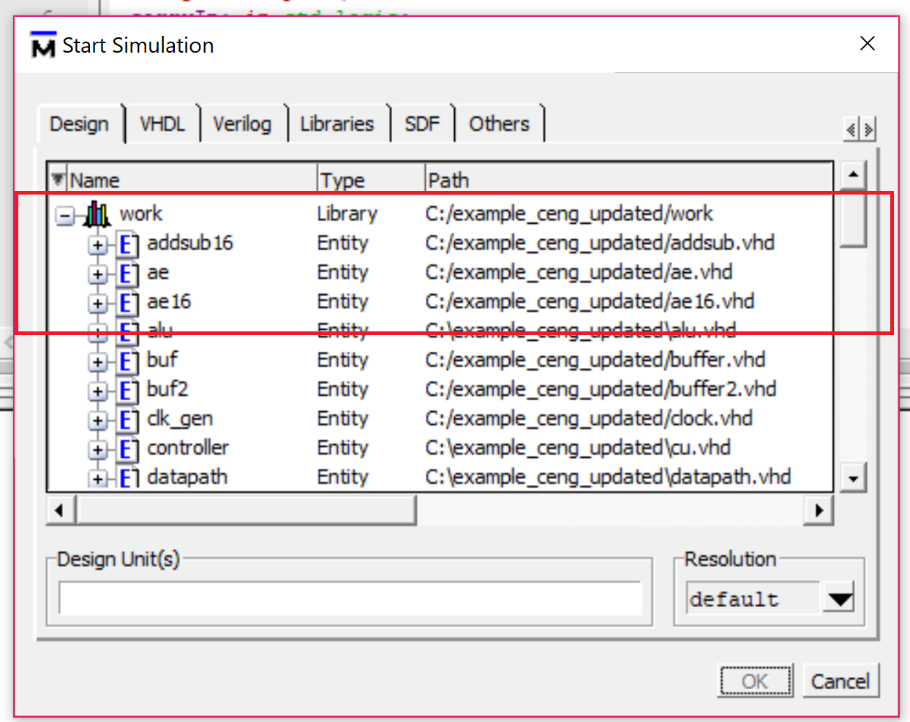
5. Now you can simulate

Slide 11
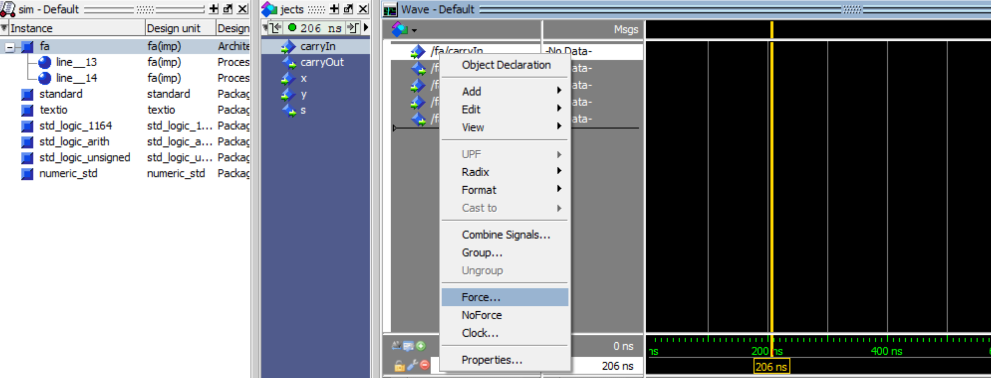
6. Right click on your input parameters and by forcing give them a value

Slide 12
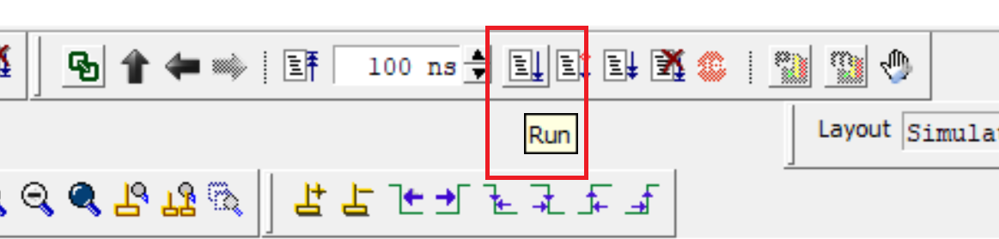
7. Run your simulation

Slide 13
U311 Microprocessor Roadmap
u311.vhd
dp.vhd cu.vhd
ALU.vhd LE16.vhd
Regfile.vhd AE16.vhd
Register16.vhd AddSub16.vhd FullAdder.vhd
Mux4.vhd Shifter16.vhd
Buf.vhd
Buf2.vhd

Slide 14
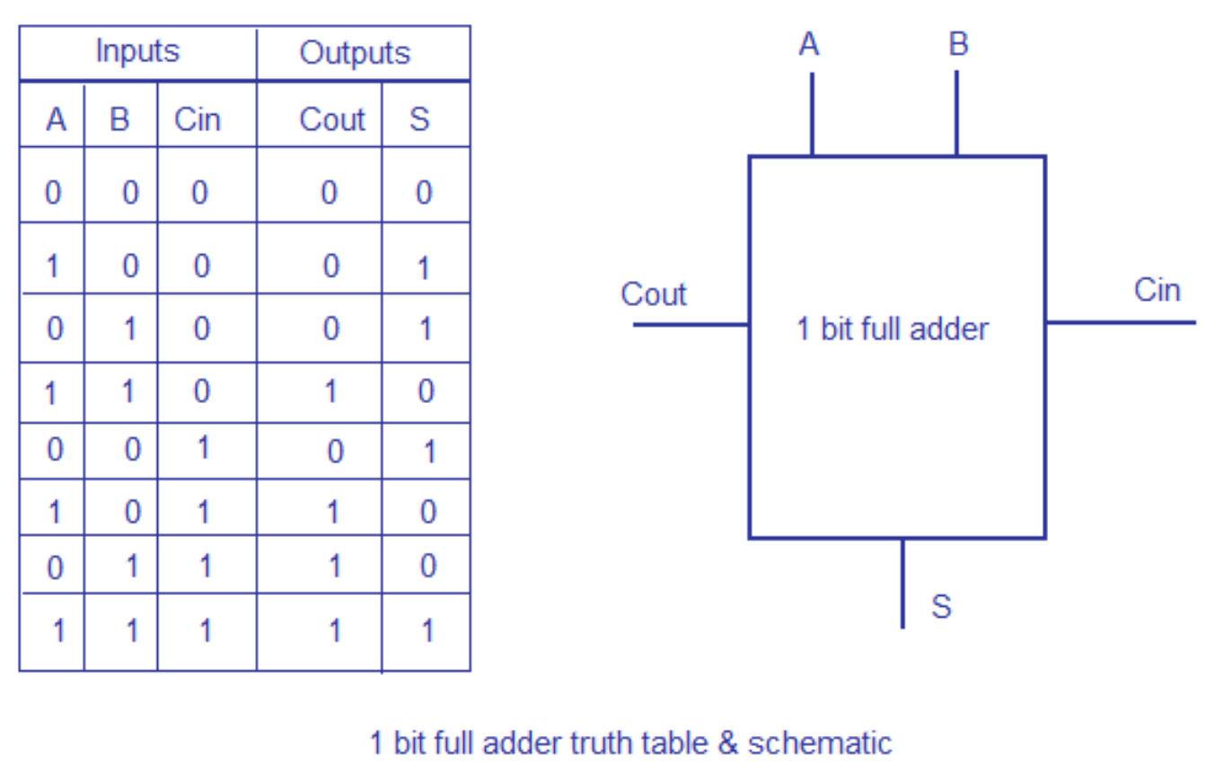
1 bit FULL ADDER (FA)

Slide 15
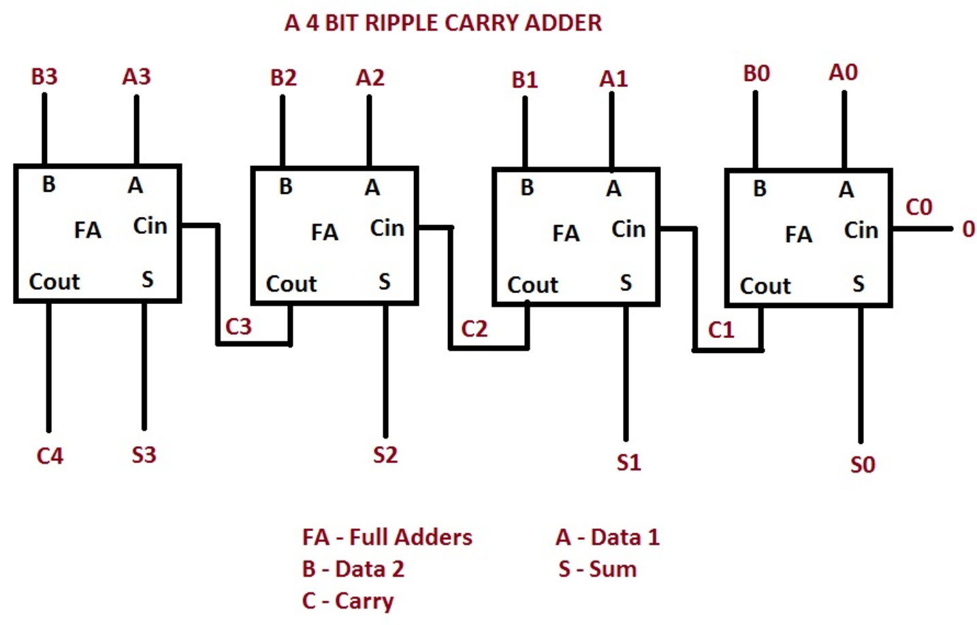
4 bits FULL ADDER (FA)

Slide 16
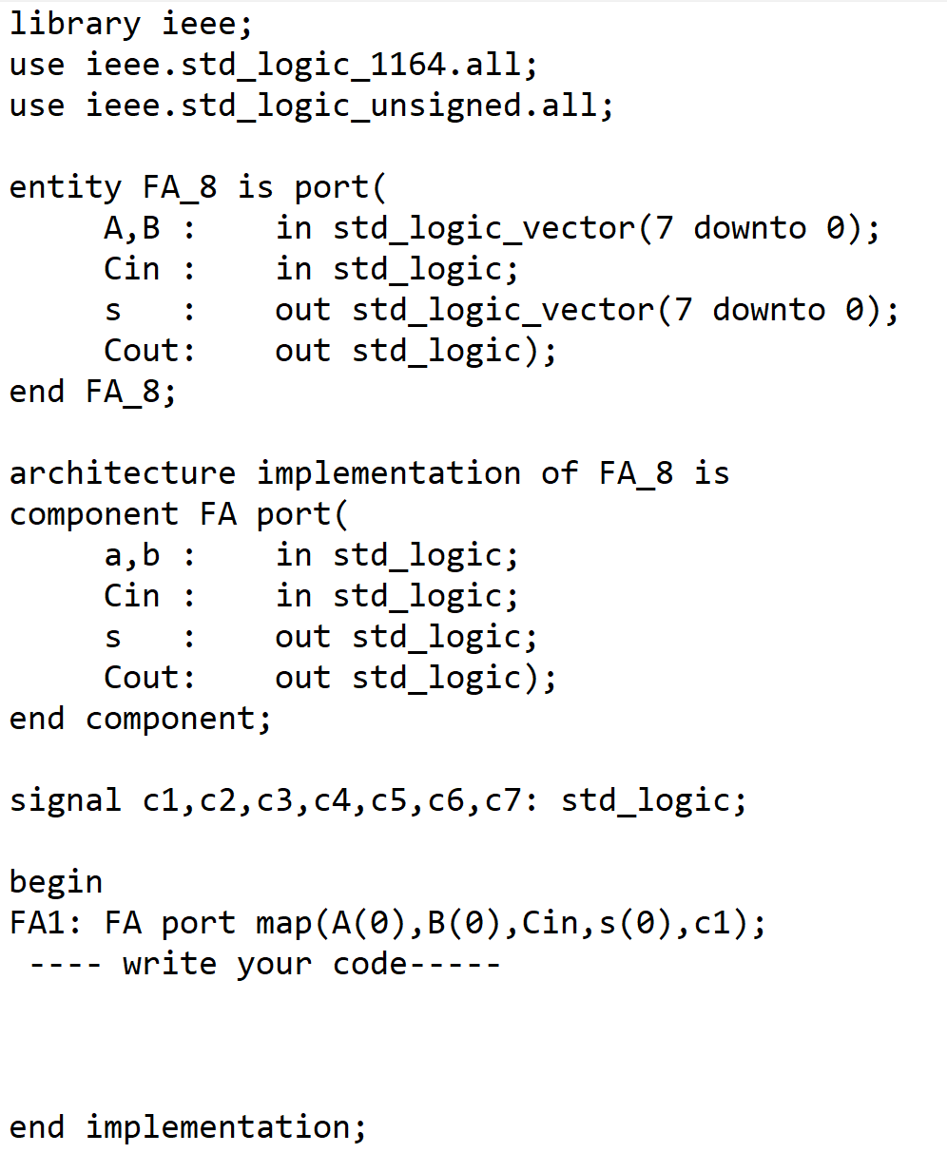
VHDL Code of 8 bit Full Adder

